Slide 1

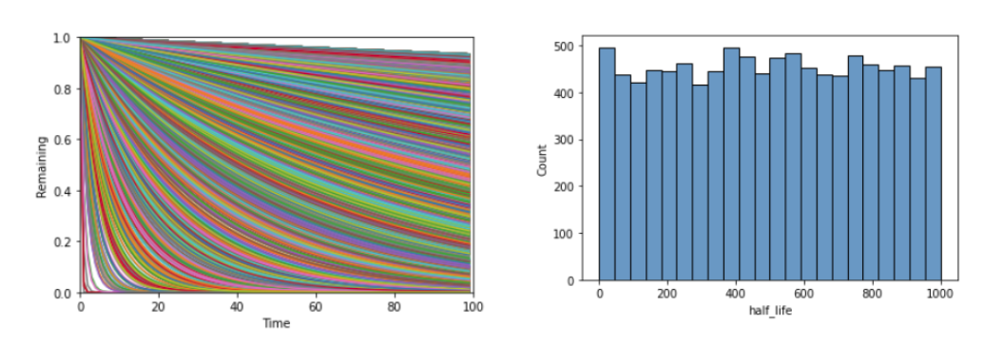
1-Variable Multitask Learning Demonstration on Exponential Decay Curves
Generated Data
with the half-life t_{1/2} corresponding to
A set of 10,000 half lives were randomly generated in the range (0, 1000). Using the exponential decay equation, the amount of theoretical substance remaining was calculated for time in the range (0, 100).
The graph of exponential decay curves used as training data (left) and the distribution of half-lives used to produce these curves (right).

Slide 2
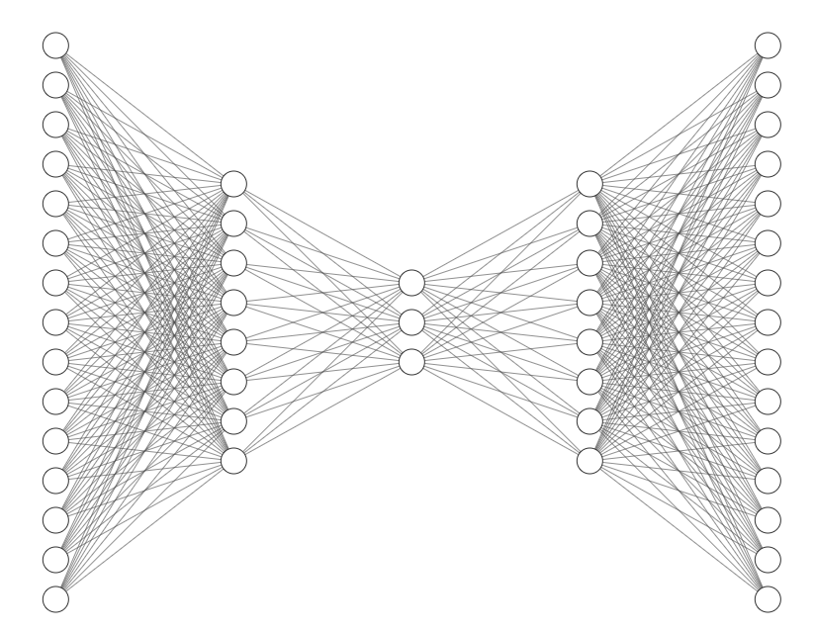
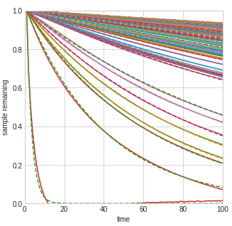
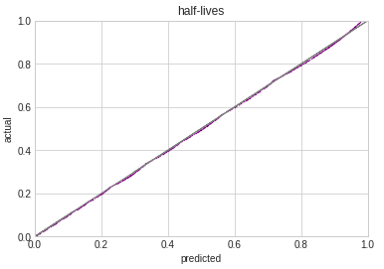
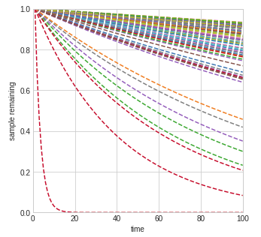
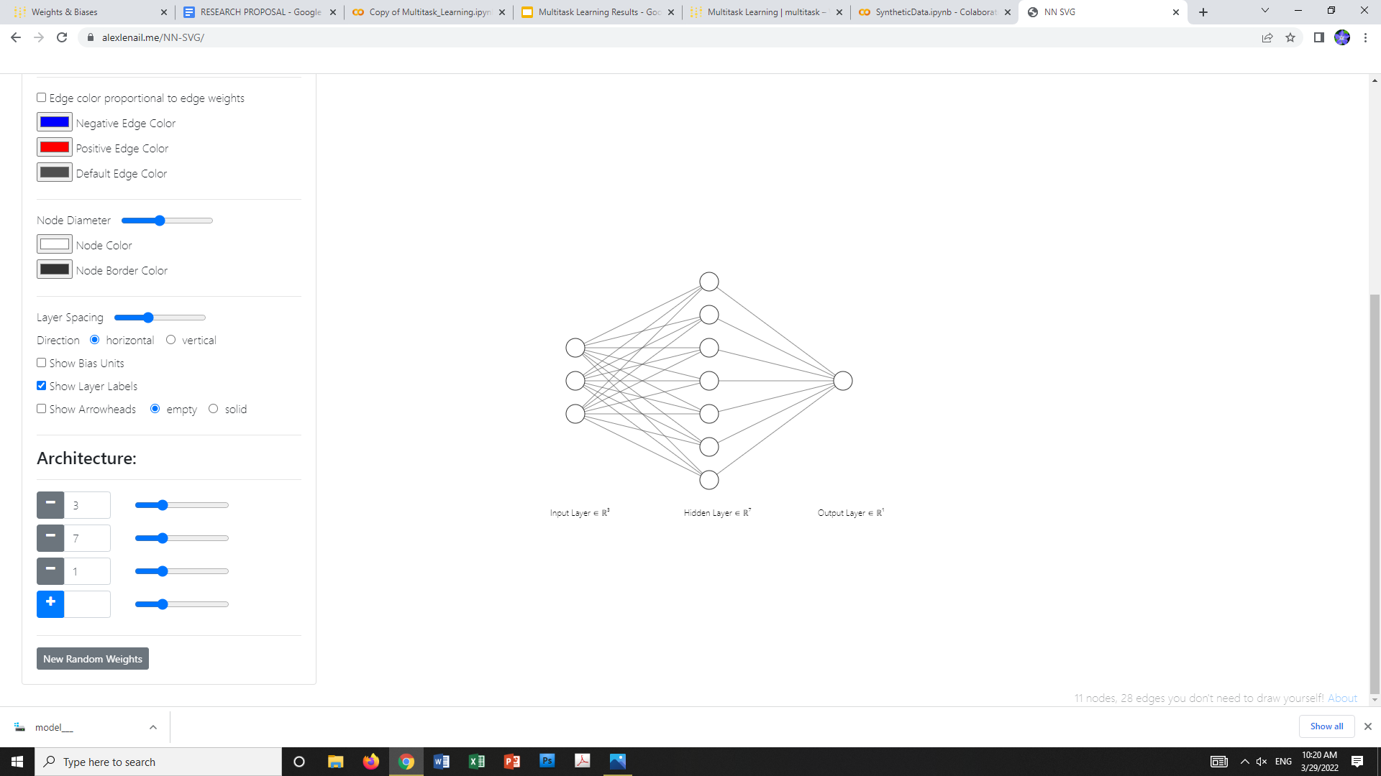
Model Architecture
Note: the encoder, decoder, and branch were not trained independently
Reconstruction as per the autoencoder (dashed lines are input curves and solid lines are the reconstructed curves).
Encoder
Decoder
Branch 1

Slide 3
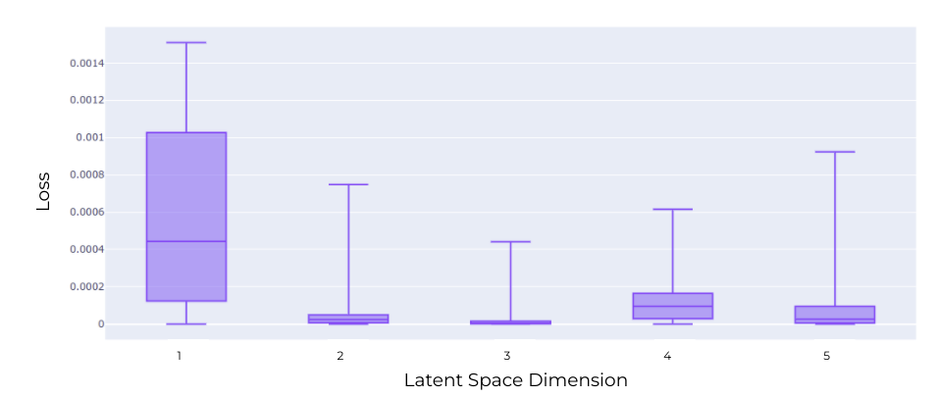
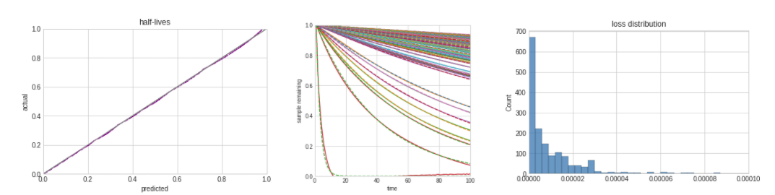
Note: hyperparameters were optimized for each number of nodes
Results
A latent space with 3 nodes presented the best results for both reconstruction and half-life prediction.
Reconstruction
The half-life prediction (left), reconstruction (center), and distribution of summed prediction and reconstruction loss (left) for a model trained with 3 nodes in the latent space.

Slide 4
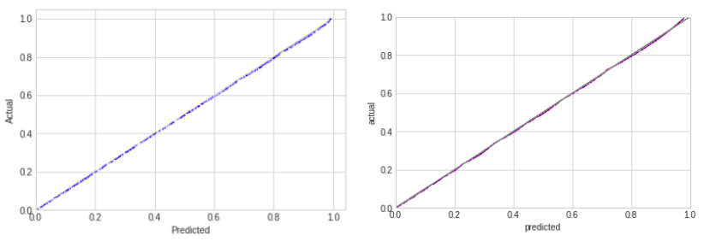
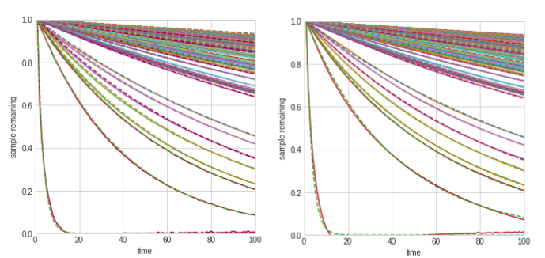
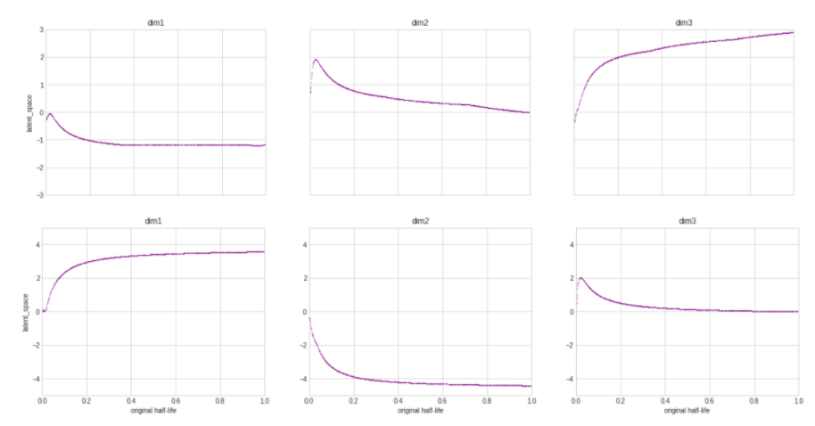
Comparisons with traditional ML techniques
Prediction accuracy using a neural network (left) and multitask learning (right).
Reconstruction accuracy using an autoencoder (top) and multitask learning (bottom).
Latent space correlation with half-lives using an autoencoder (bottom) and multitask learning (top).

